Slide 1

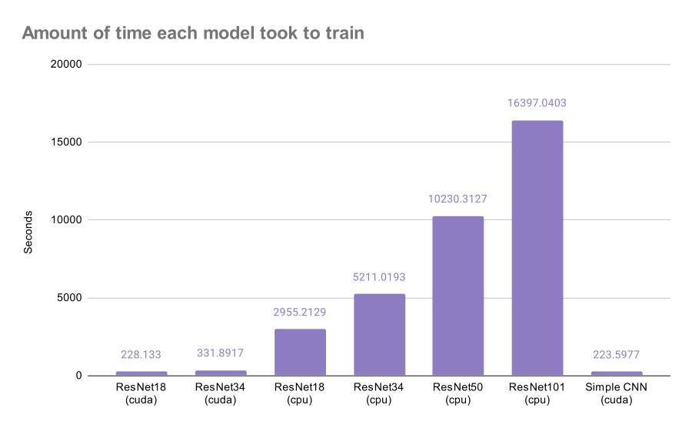
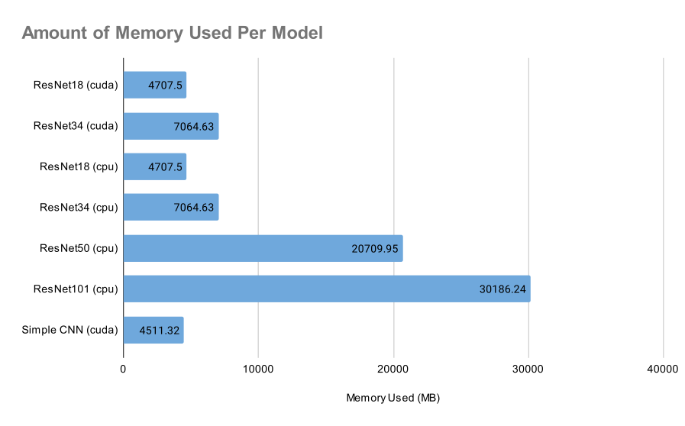
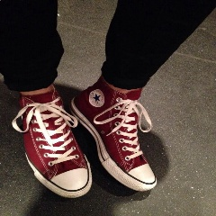
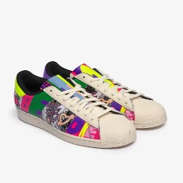
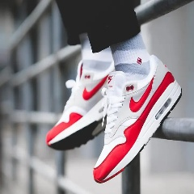
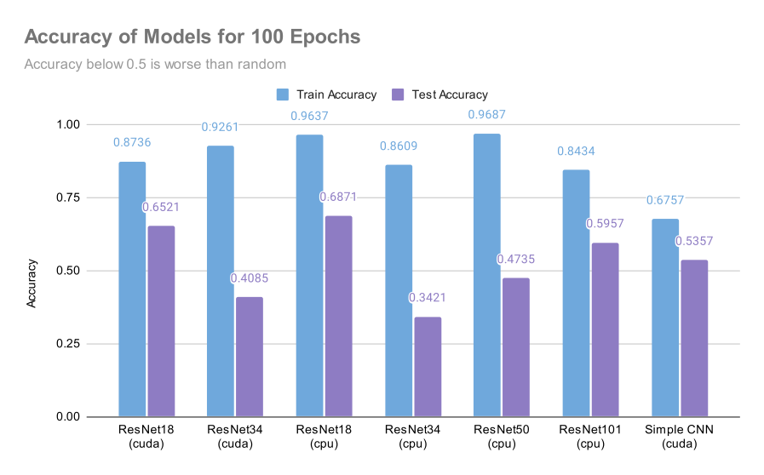
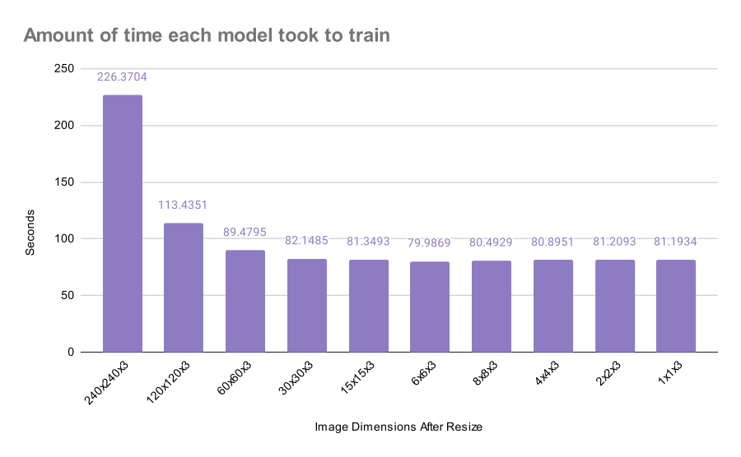
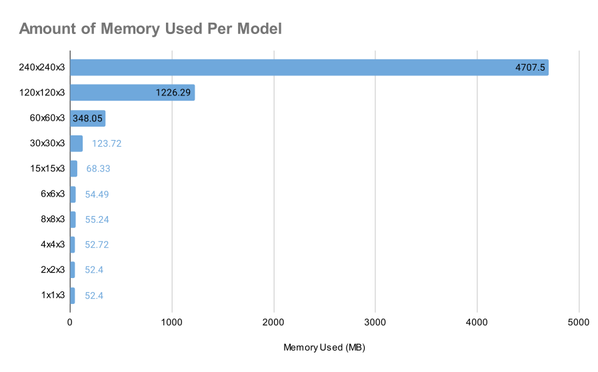
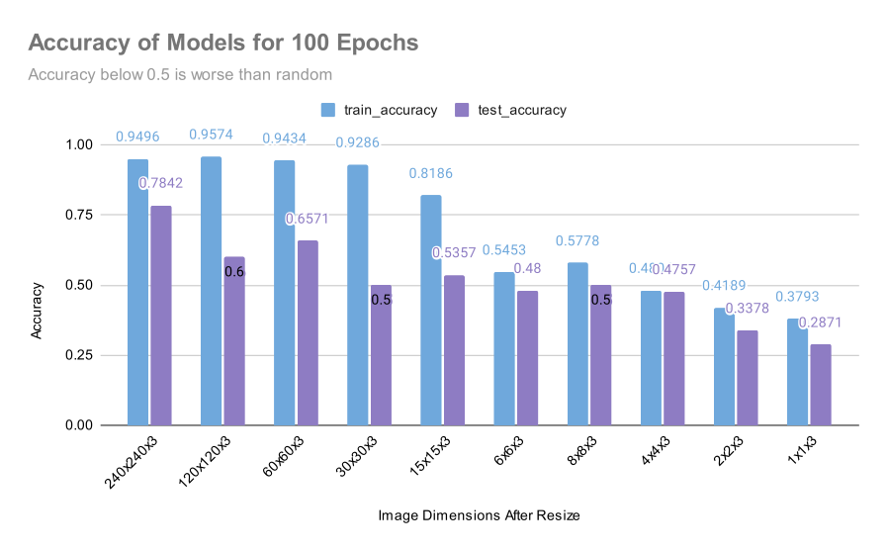
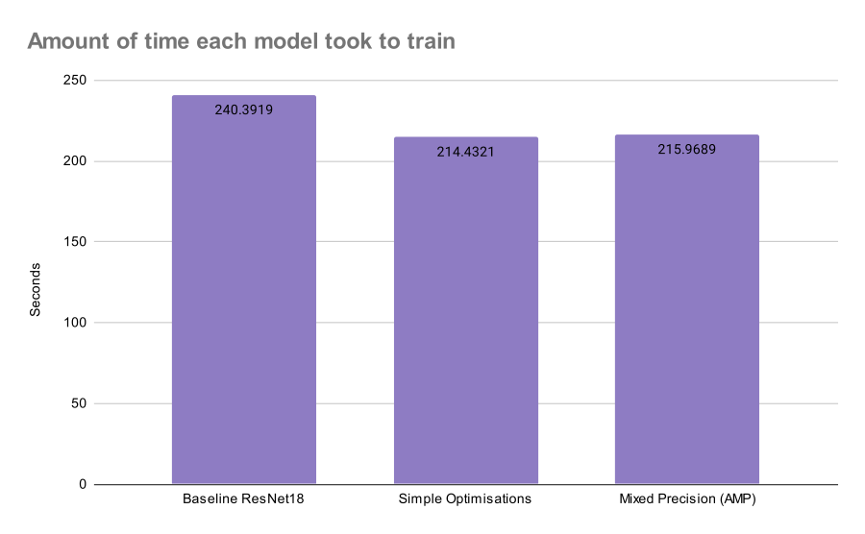
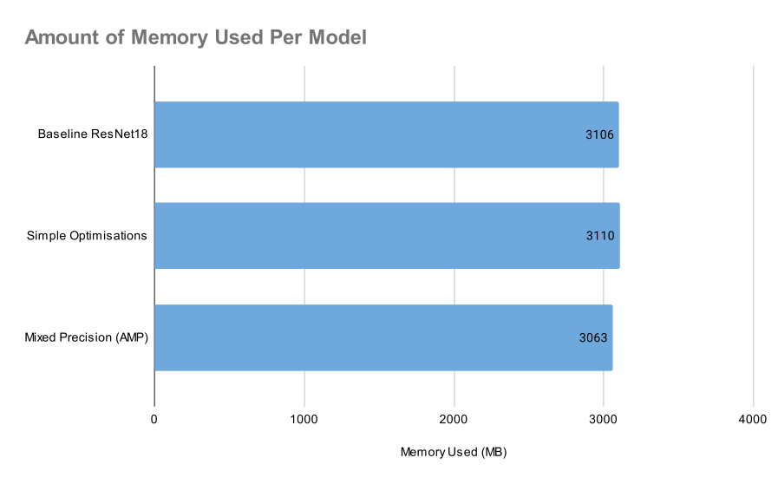
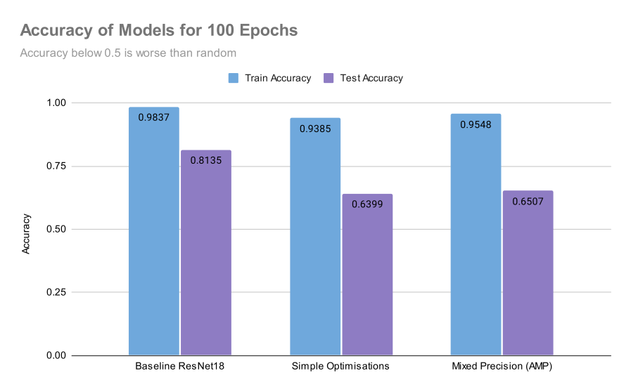


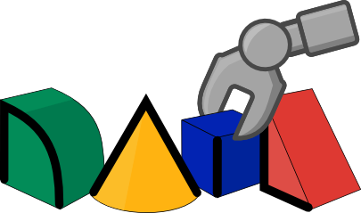

Computer Vision does not have to rely on the biggest and most expensive models to produce viable results.
Access to vision systems, for example AI on the Edge does not have to be costly to get good results
Methodology
• Simple classification problem – type of Shoes
• Metrics to Evaluate:
- Accuracy of classification
- Time to complete experiment
- Amount of memory used
dataset used found at: https://www.kaggle.com/datasets/die9origephit/nike-adidas-and-converse-imaged
Comparing Image Inputs
Other Optimisations
Jason Chalom¹
Supervisor: Dr Richard Klein¹
¹University of the Witwatersrand, South Africa
RAIL Lab
Write-up found here

